Slide 1
Typescript – callbacks, promises and async await
Vs code tricks
Ctr + p – search files by file name
Ako right click na folder ot VS code i open in terminal -> direktno ni selectira dir-a na fodlera i niama nujda da pravim cd
Install in VS code thse extensions:
esLint –checks for js issues - https://eslint.org/
Prettier –code formatter
Notes:
Course Pluralsight:
Creating Asynchronous TypeScript Code – Lector: John Papa
https://app.pluralsight.com/library/courses/typescript-asynchronous-code/table-of-contents

Slide 2
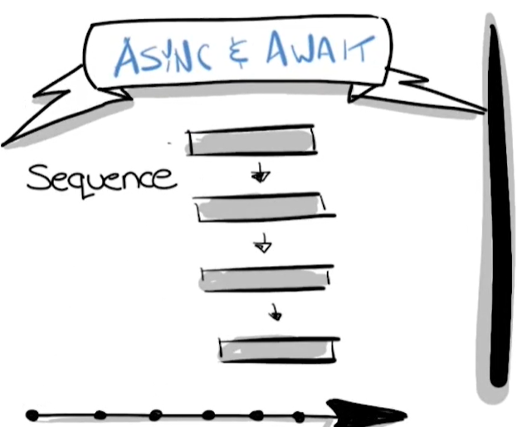
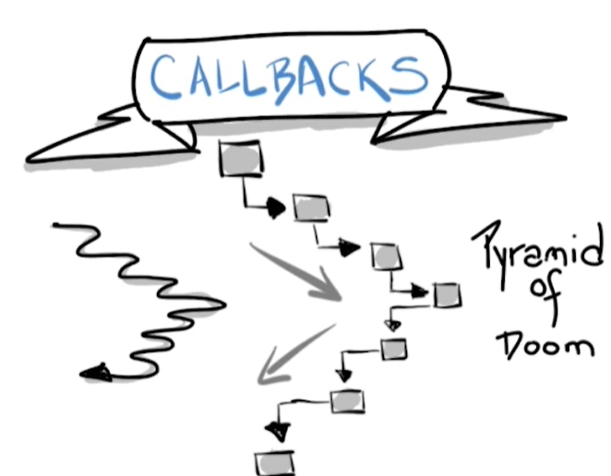
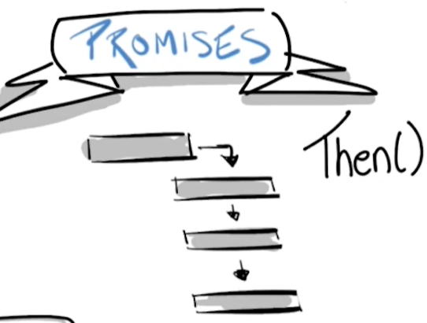
3 async patterns: callbacks, promises and async await
1. Callbacks – we call 1 callback func, then another then another. This is also called pyramid of doom as it is difficult to maintien
2. Promises – we start our code in the 1st rectangle and then when it is done we call our next code – simplier to code and maintien
3. Async & Await – allow us to treat async code as we treat sync code – go to this and when you are done do the next thing

Slide 3
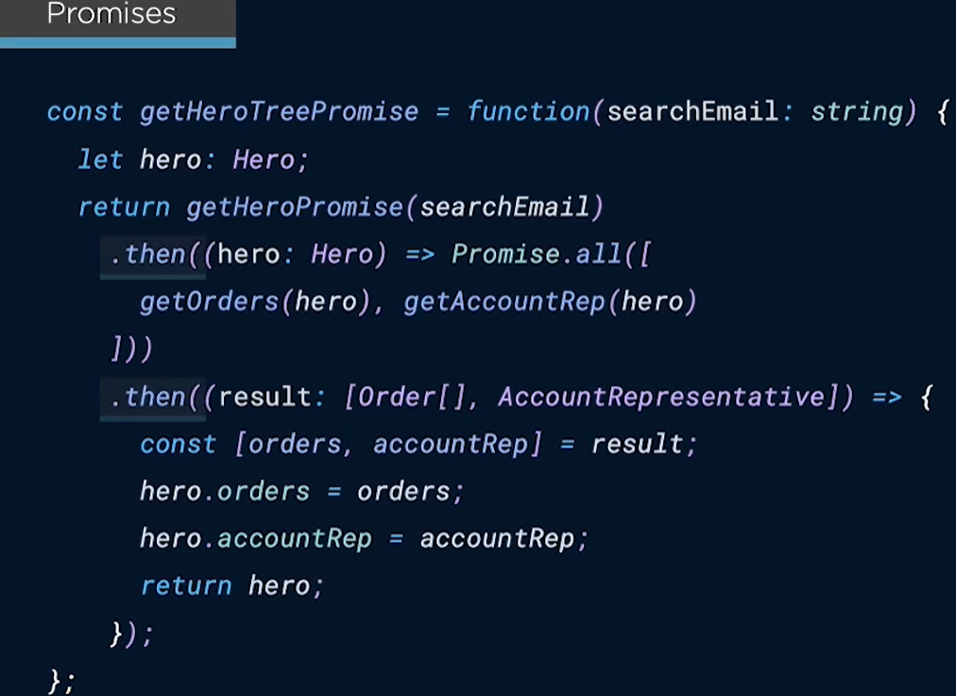
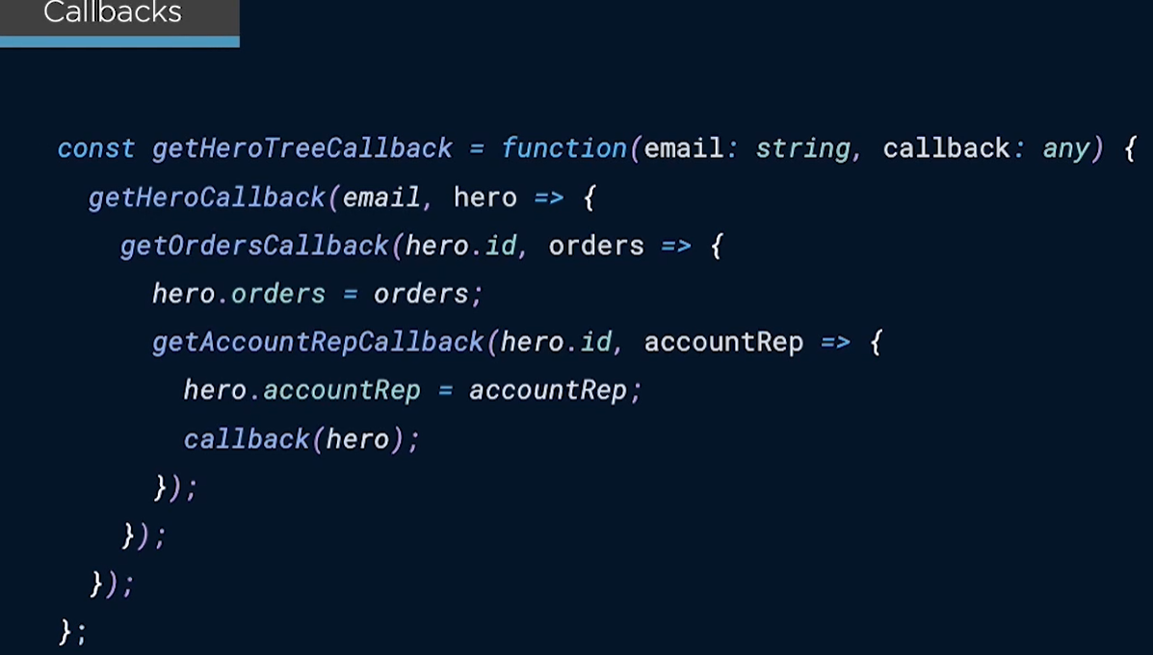
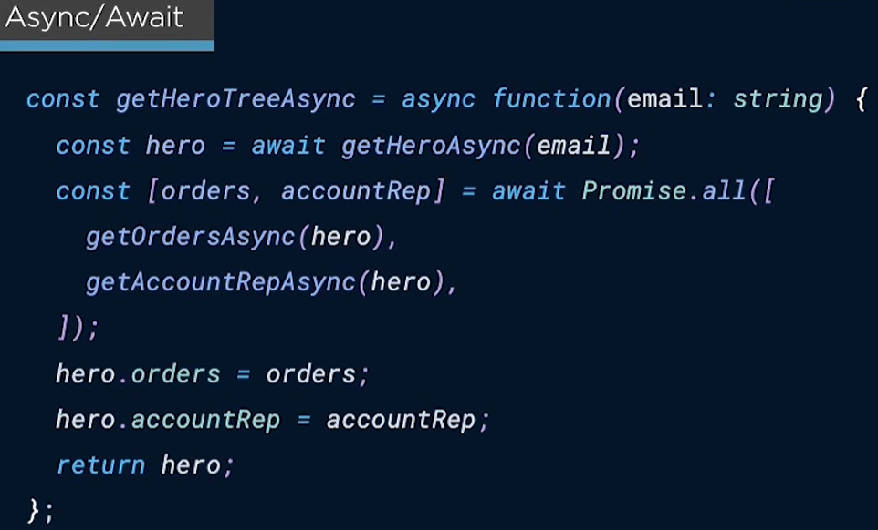
examples
Promiss all -> with it we do the 2 calls in the
same time and when they are done we go
on the next then.
With the callback we dont have that.
Async/await – it makes the code look sync

Slide 4
Timeouts and intervals
setTimeout() – execute a specified block of code once after a specified time has elapsed
setInterval() – execute a specified block of code repeatedly with a fixed time delay between each call.
Axios -> one of the most popular libraries to do http calls

Slide 5
Callback pattern
export function getDataAfterDelay(
delayMs:number,
callback: (data:string[]) => void){ //as the callback returns a function
setTimeout(() => {
const data = ingredients;
//we call our callback func and pass the data, this will happen after the delay time
callback(data);
}, delayMs);
}
//I posle ia vikame taka function getIngredients() {
showMessage('Ingredients for baking amazing cookies:', 'Ingredients');
getDataAfterDelay(1500, showIngredients);
function showIngredients(ingredients:string[]){
ingredients.forEach(i => showMessage(`${i}`, 'Ingredients', true))
}
}

Slide 6
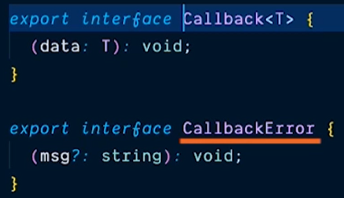
Callback – getting data
const getOrdersCallback = function(
heroId: number,
callback: Callback<Order[]>,
callbackError?: CallbackError,
) {
const url = heroId ? `${apiUrl}/orders/${heroId}` : `${apiUrl}/orders`;
axios
.get(url)
.then((response: AxiosResponse<Order[]>) => {
const orders = parseList<Order>(response);
callback(orders);
})
.catch((error: AxiosError) => {
console.error(`Developer Error: Async Data Error: ${error.message}`);
callbackError(`Oh no! We're unable to fetch the Orders`);
});
};
const getAccountRepCallback = function(
heroId: number,
callback: Callback<AccountRepresentative>,
callbackError?: CallbackError,
) {
const url = `${apiUrl}/accountreps/${heroId}`;
axios
.get(url)
.then((response: AxiosResponse<AccountRepresentative>) => {
const list = parseList<AccountRepresentative>(response);
const accountRep = list[0];
callback(accountRep);
})
.catch((error: AxiosError) => {
console.error(`Developer Error: Async Data Error: ${error.message}`);
callbackError(`Oh no! We're unable to fetch the Account Rep`);
});
};
export const getHeroTreeCallback = function(
email:string,
callback: Callback<Hero>,
callbackError?: CallbackError
){
getHeroCallback(email, function(hero: Hero){
//the 2d param function is the successful callback of getting the orders
getOrdersCallback(hero.id, function(orders: Order[]){
hero.orders = orders;
getAccountRepCallback(hero.id, function(accountRep:AccountRepresentative){
hero.accountRep = accountRep;
//in the end we call the original callback to pass back the hero we constructed
callback(hero);
})
})
})
};
const getHeroCallback = function(
email: string,
callback: Callback<Hero>,
callbackError?: CallbackError,
) {
axios
.get<Hero[]>(`${apiUrl}/heroes?email=${email}`)
.then((response: AxiosResponse<Hero[]>) => {
const data = parseList<Hero>(response);
const hero = data[0];
callback(hero);
})
.catch((error: AxiosError) => {
console.error(`Developer Error: Async Data Error: ${error.message}`);
callbackError(`Oh no! We're unable to fetch the Hero`);
});
};

Slide 7
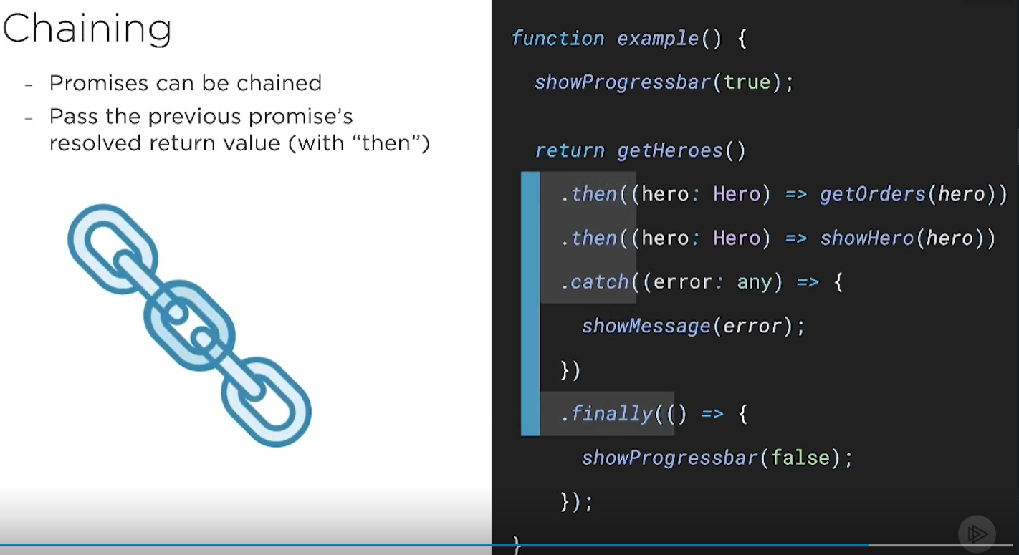
Promises pattern
Fulfilled ->Resolved promise
Rejected -> it means it fails
Pending -> the promise is neither fulfilled neither rejected
Settled -> the promise has been either fulfilled or rejected
Finally will be always executed: in success and in fail

Slide 8
Creating promises
export let getHeroesViaPromise: () => Promise<Hero[]> = function() {
return delay(1000).then(() => getHeroesDelayedAsync());
};
* Return a fulfilled promise after a given delay.
const delay: (ms:number) => Promise<void> = function(ms:number) {
return new Promise<void>(resolve => setTimeout(resolve,ms));
};
* Return a fulfilled promise of heroes
const getHeroesDelayedAsync: () => Promise<Hero[]> = () => {
//heroes is a collection of heroes coming from a file
return new Promise<Hero[]>(resolve => resolve(heroes))
};
//nakraia vikame async funcs
function resolvedPromise() {
showFetching();
showMessage();
// get heroes, with a Promise
getHeroesViaPromise()
.then(showHeroes)
.catch(handleErrors)
.finally(wrapUp)
}

Slide 9
Resolve & reject promises
export let getHeroesViaNewPromise: () => Promise<Hero[]> = function(){
const newPromise = new Promise<Hero[]>((resolve, reject) => {
return delay(1000)
.then(() => getHeroesDelayedAsync())
.then((heroes: Hero[]) => {
if(heroes && heroes.length){
resolve(heroes);
} else {
reject(Error('Oh! Error!'));
}
})
});
return newPromise;
};
function resolvedUsingPromiseConstructor() {
showFetching();
showMessage();
// get heroes, with new Promise
getHeroesViaNewPromise()
.then(showHeroes)
.catch(handleErrors)
.finally(wrapUp)
}

Slide 10
Error handling and rejecting promises
const getHeroesEmpty: () => Promise<Hero[]> = () =>{
return new Promise<Hero[]>(resolve => resolve([]));
};
//gornata ama sukratena
//const getHeroesEmpty: () => Promise<Hero[]> = () => Promise.resolve([]);
*/
export let getHeroesViaPromiseReject: () => Promise<Hero[]> = function() {
const newPromise = new Promise<Hero[]>((resolve, reject) => {
return delay(1000)
.then(() => getHeroesEmpty())
.then((heroes: Hero[]) => {
if(heroes && heroes.length){
resolve(heroes);
} else {
reject(Error('Oh! Error!'));
}
})
});
};
//gornata ama sukratena
export const getHeroesViaPromiseRejectShorter: () => Promise<Hero[]> = function() {
const getsHeroesOrDoesIt = () =>
Promise.reject('bad error occurred getting the heroes');
return delay(1000).then(() => getsHeroesOrDoesIt());
};
function rejectedPromise() {
showFetching();
showMessage();
// rejected promise
getHeroesViaPromiseReject()
.then(showHeroes)
.catch(handleErrors)
.finally(wrapUp)
}
Calling multiple promises on the same time: promise all
const getHeroTreePromise = function(searchEmail: string) {
let hero: Hero;
return getHeroPromise(searchEmail)
.then((h: Hero) => {
hero = h;
return h;
})
.then((hero: Hero) =>
Promise.all([getOrdersPromise(hero.id), getAccountRepPromise(hero.id)]),
)
.then((result: [Order[], AccountRepresentative]) => mergeData(result));

Slide 11
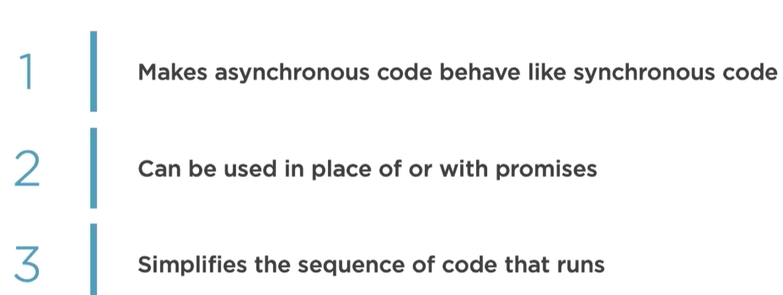
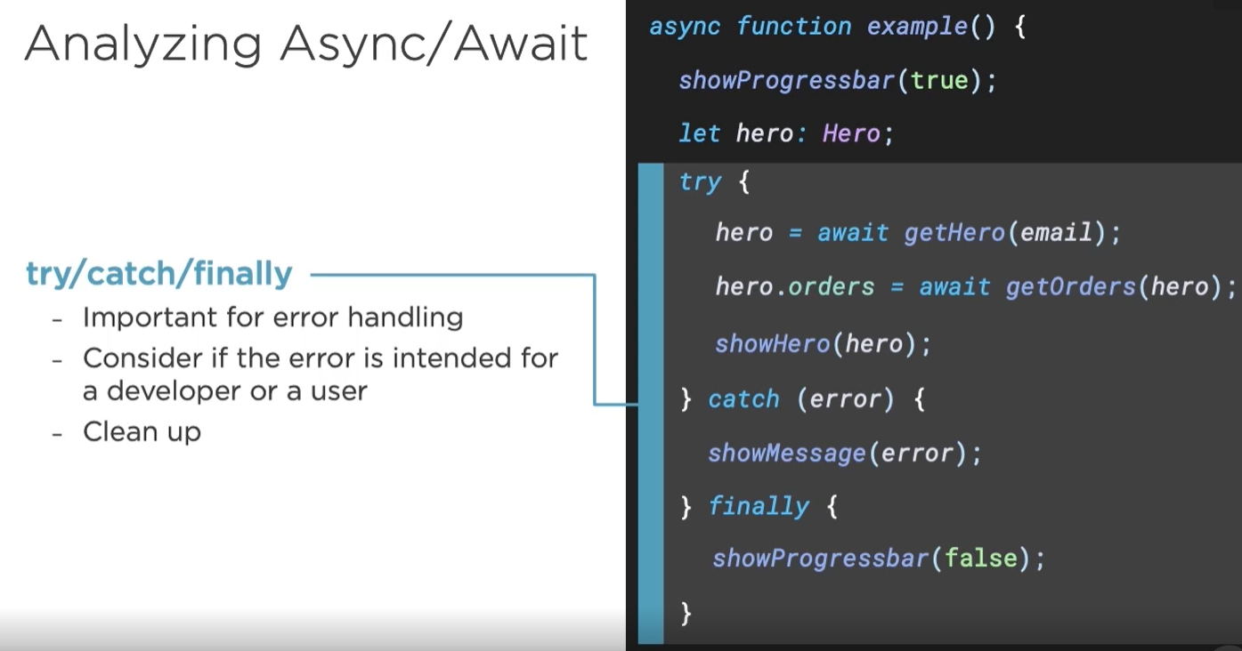
Async/await pattern

Slide 12
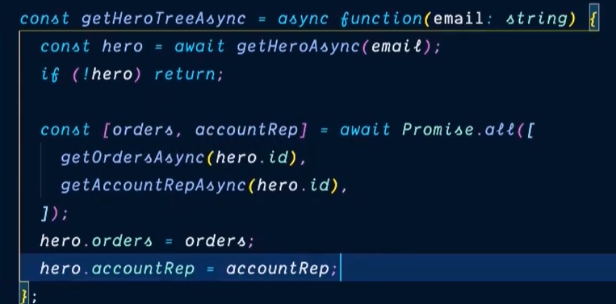
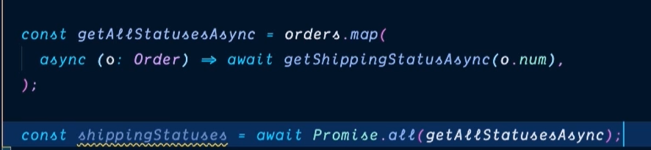
Async/await with promise all
We destructure the array to assign values
tuk mapvame order statusa ama ne izvurshvame call-a,
prosto gi slaga v array
I posle s promise all zadeystvame calla

Slide 13
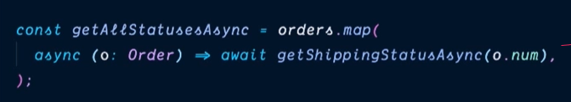
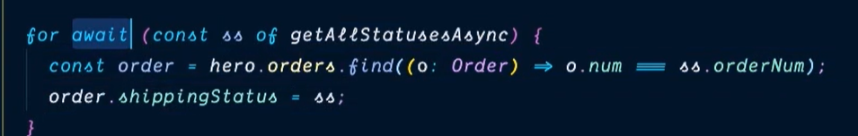
Async/await – for await
For await is alternative to promise all

